Slide 1

Limiting Spectral Distribution
2019.07.18
Shao-Hsuan Wang

Slide 2
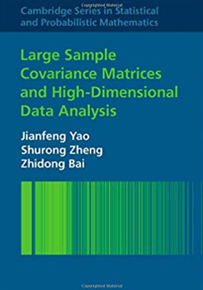
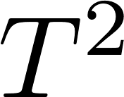
Introduction
Limiting Spectral Distributions
CLT for Linear Spectral Statistics
The Generalized Variance and Multiple Correlation Coefficient
The -Statistic
Classification of Data
Testing the General Linear Hypothesis
Testing Independence of Sets of Variates
Testing Hypotheses of Equality of Covariance Matrices
Estimation of the Population Spectral Distribution
Large-Dimensional Spiked Population Models
Efficient Optimization of a Large Financial Portfolio

Slide 3
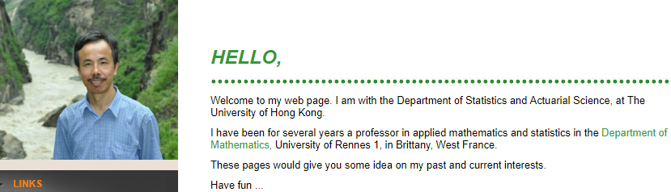

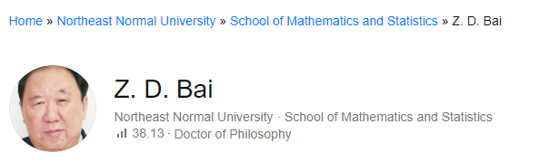

Slide 4
Multivariate analysis problem
:d

Slide 5
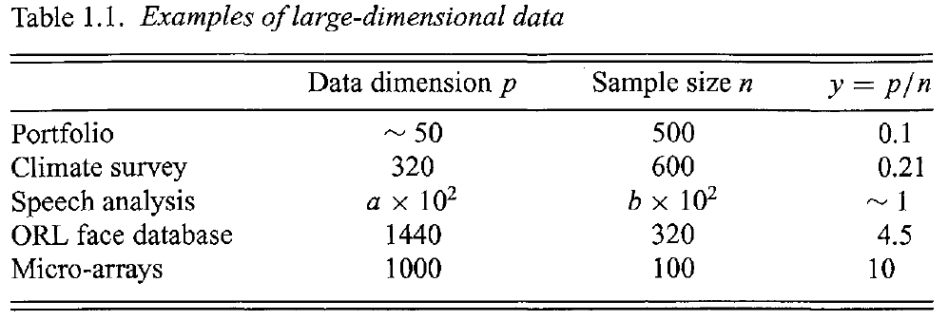
Large-dimensional data
:d

Slide 6
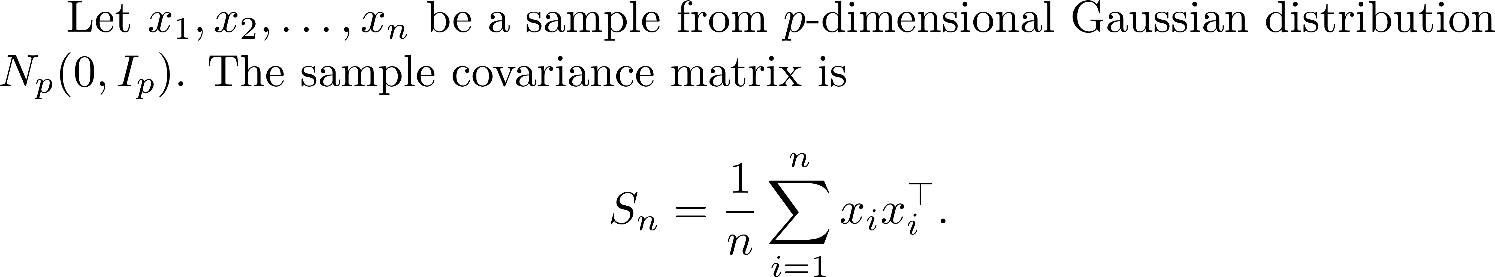
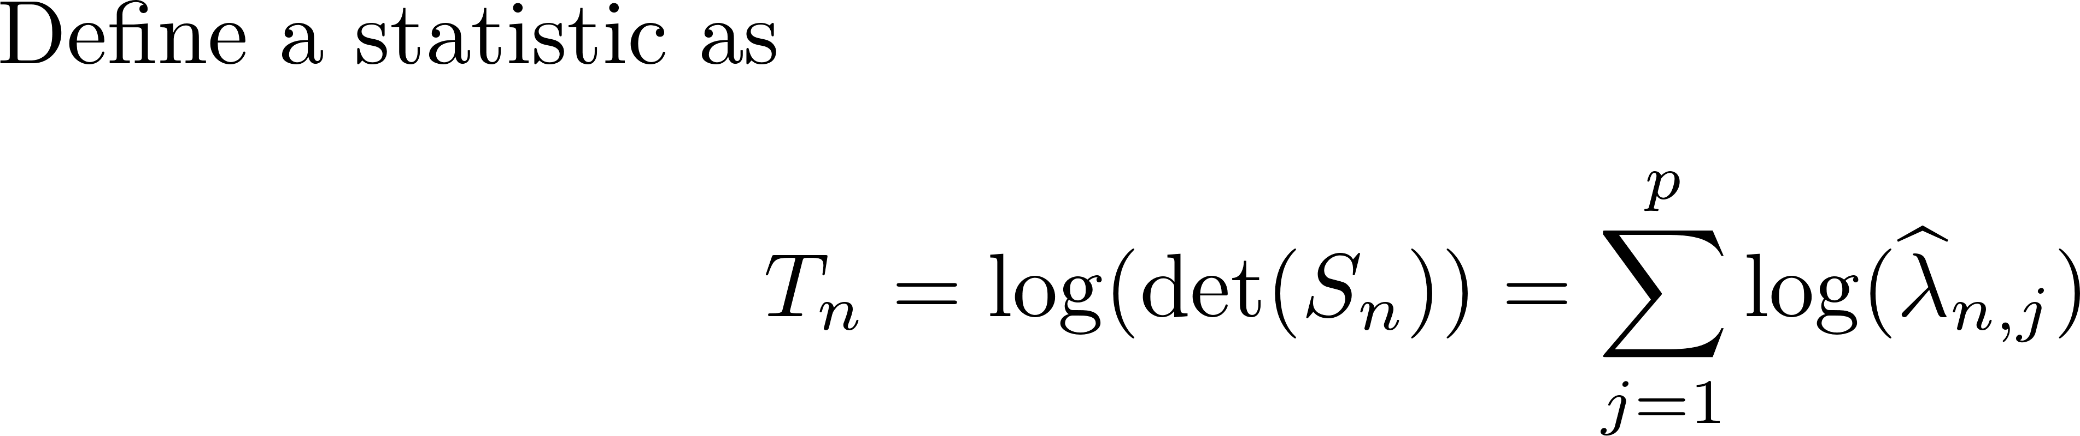
When classical large sample theory fails
:d

Slide 7
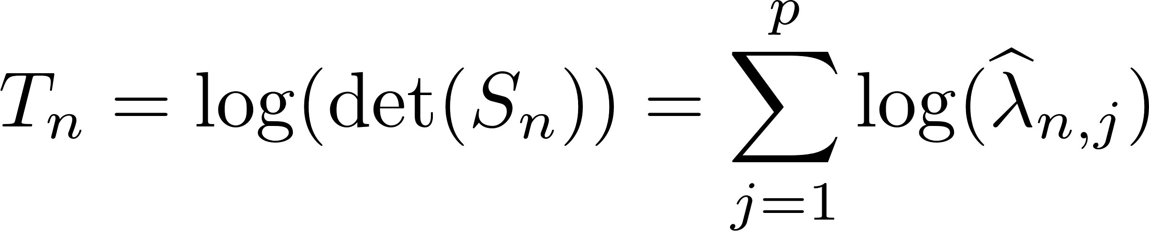
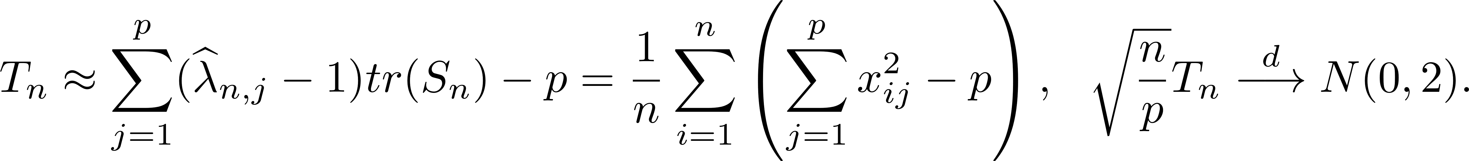
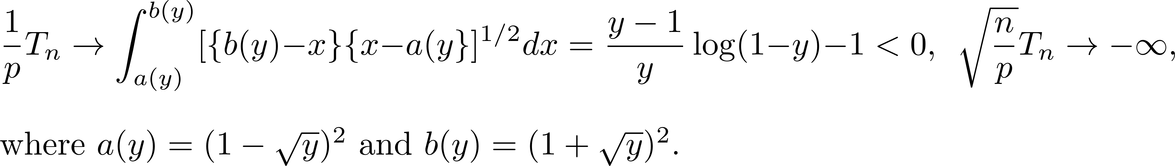
When classical large sample theory fails
:d

Slide 8
Random Matrix Theory
Semicircular law
For Gaussian Matrix
(Wigner)
Marcenko-Pastur law
(Marcenko, Pastur)
Quantum mechanics
1940s -1950s
1955 -1958
1967 -1973
Refer to Mehta’s (2004) Random Matrices

Slide 9
Random Matrix Theory
The asymptotic theory of spectral analysis of large-dimensional sample covariance matrices
(Bai, Yin, Jonsson, Wachter, Krishnaiah et al.)
1977 -1988
2019
Refer to Mehta’s (2004) Random Matrices

Slide 10
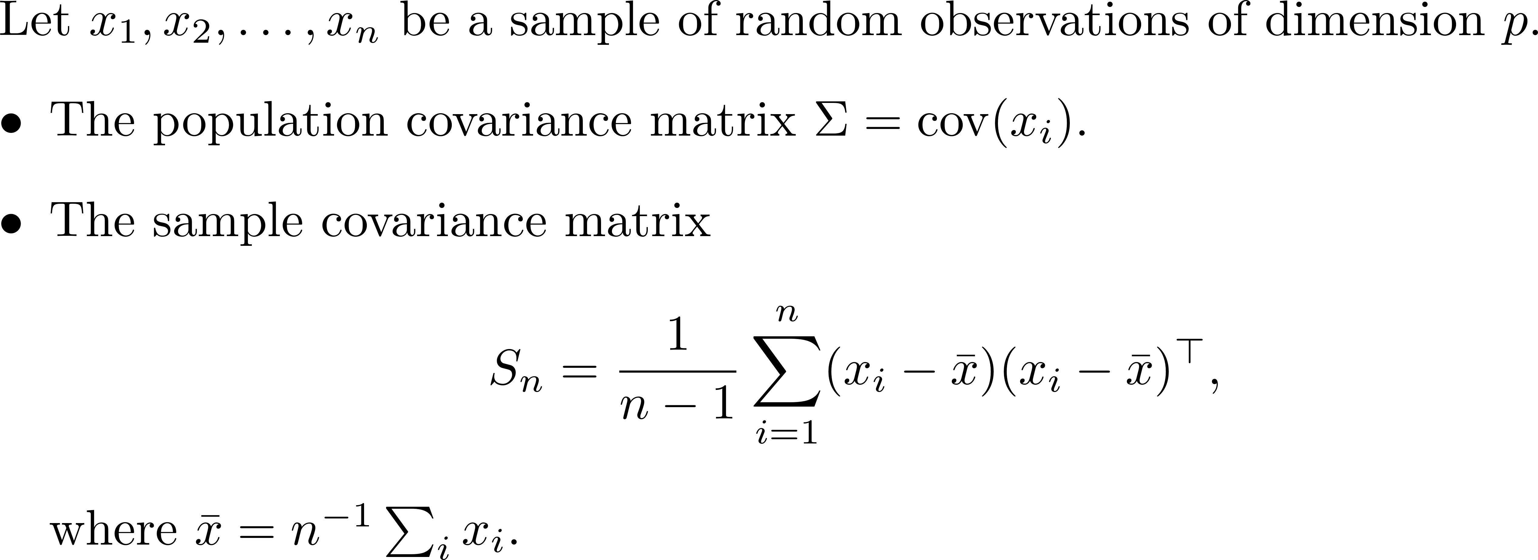
Eigenvalue Statistics of Large Sample Covariance Matrices

Slide 11
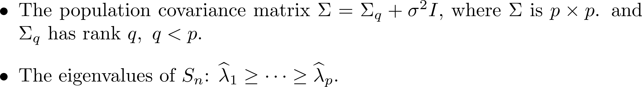
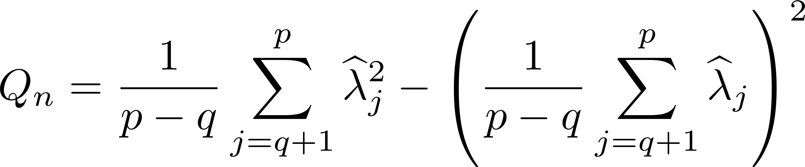
Example: Rank selection

Slide 12

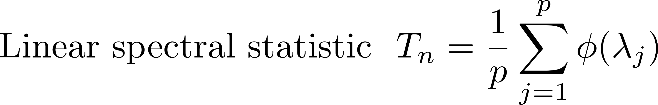
Linear spectral statistic of
the sample covariance matrix

Slide 13
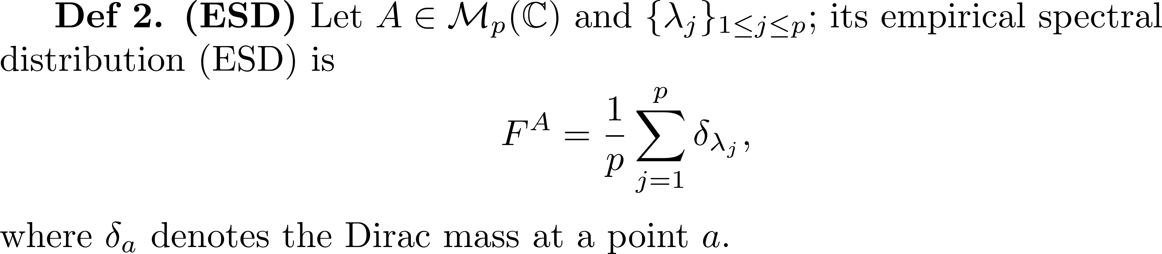
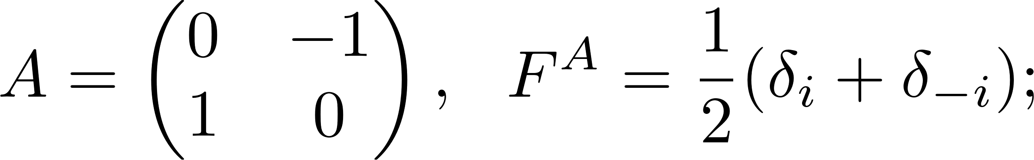
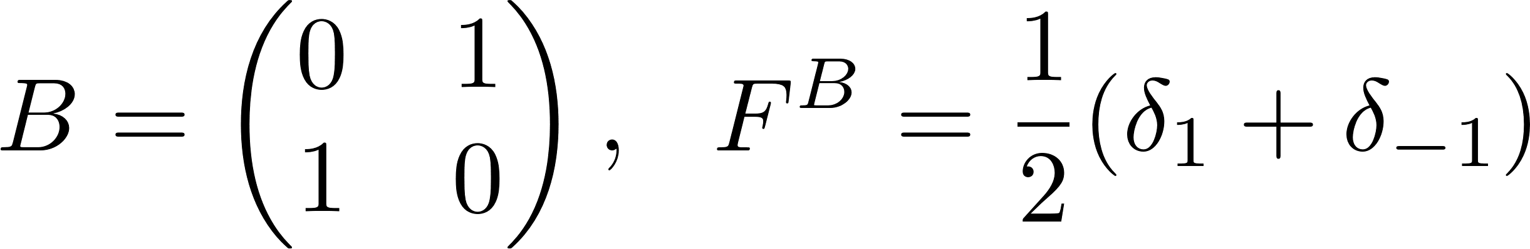
Definitions

Slide 14
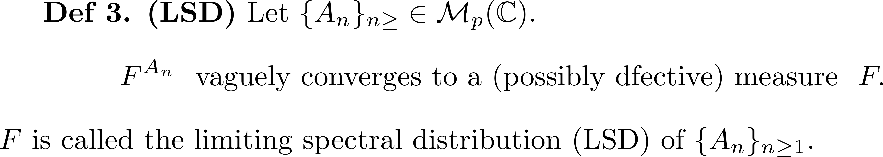

Slide 15
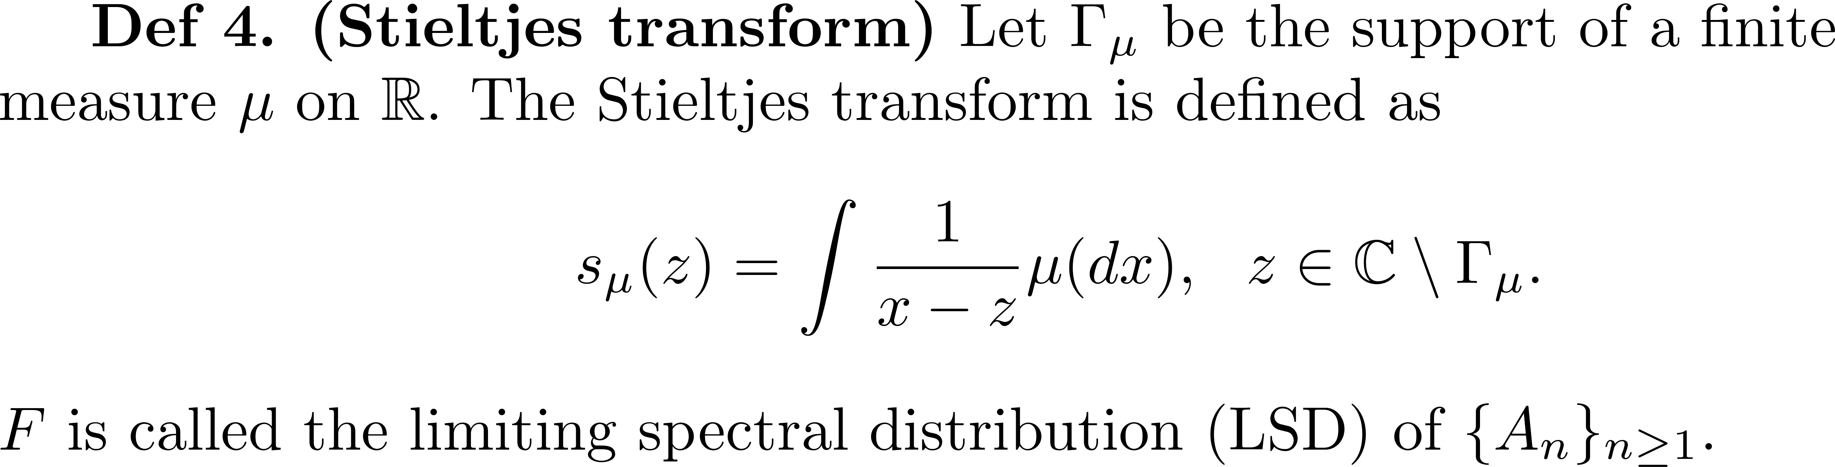

Slide 16
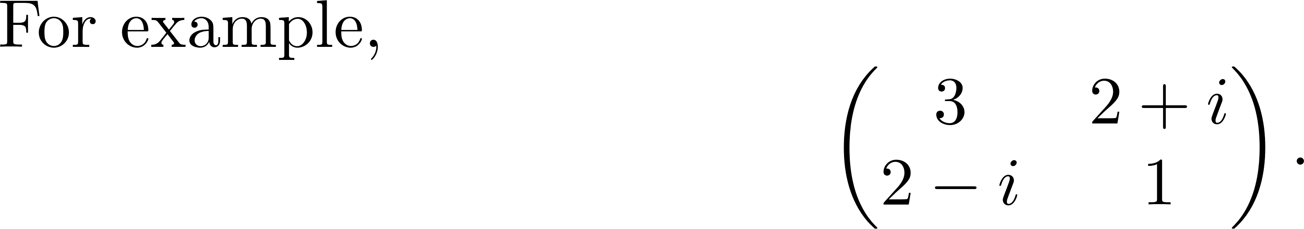

Slide 17
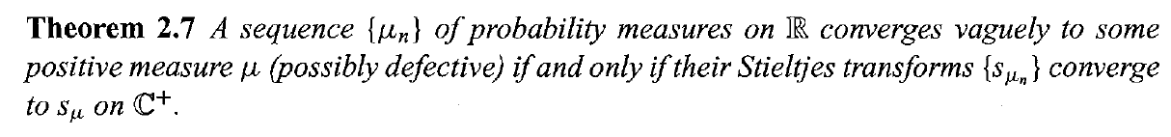
Characteristic

Slide 18
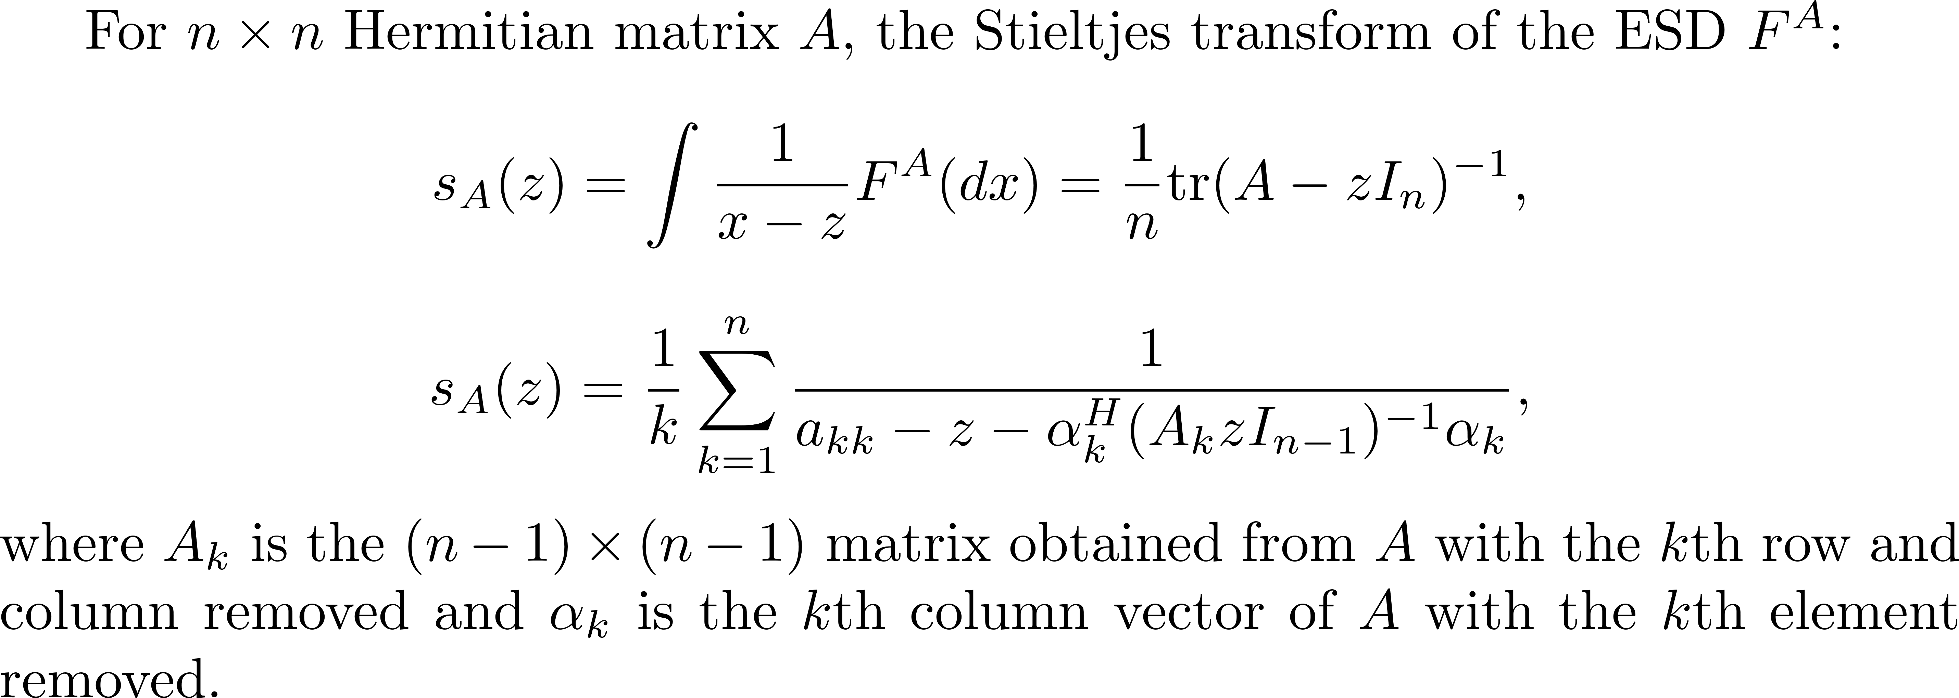

Slide 19
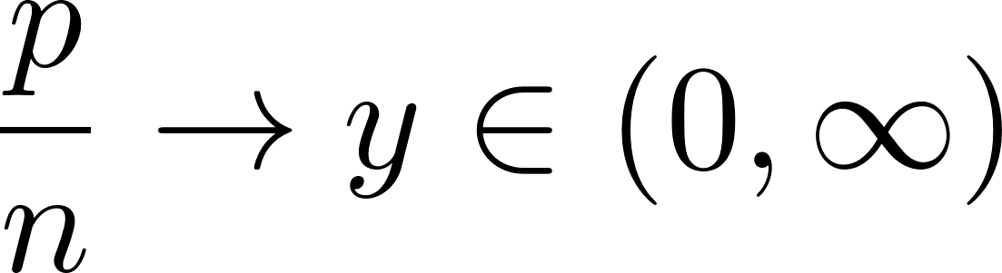
Random matrix

Slide 20
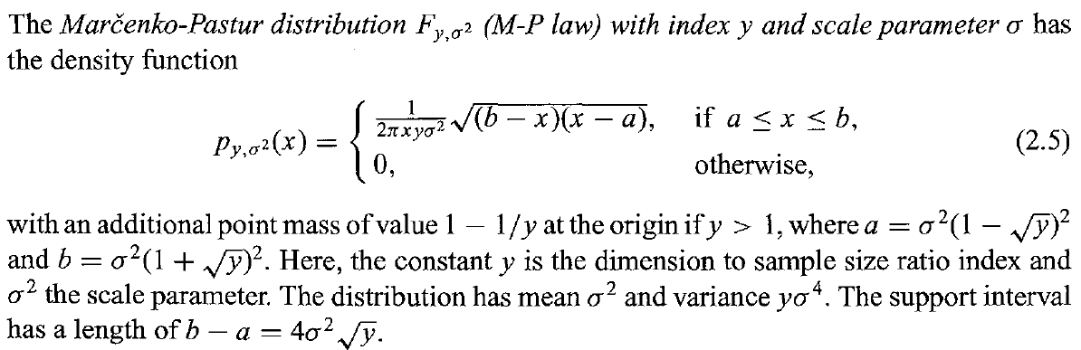
Marcenko-Pastur Distriubtions

Slide 21
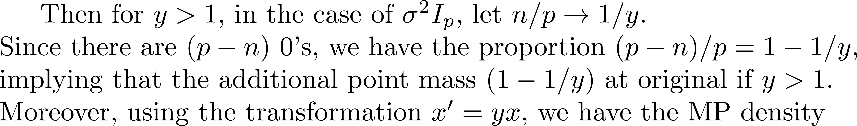
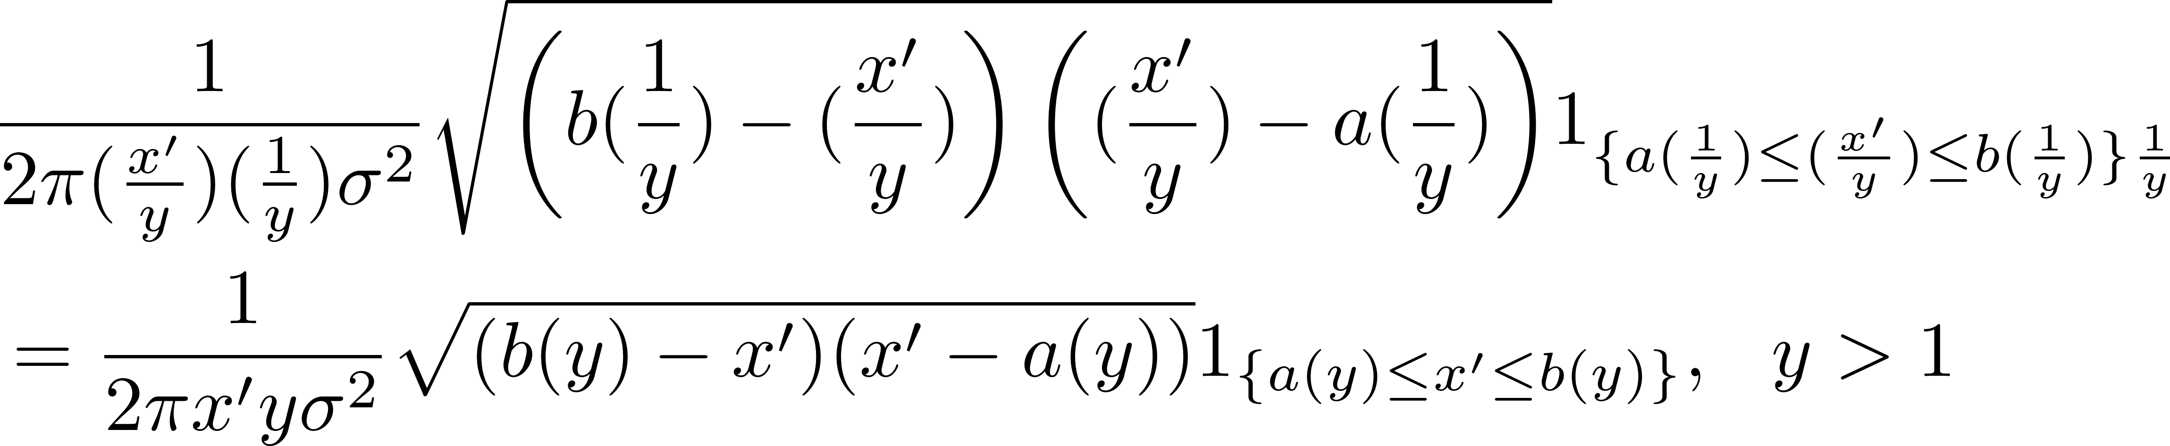
Remark 1:

Slide 22
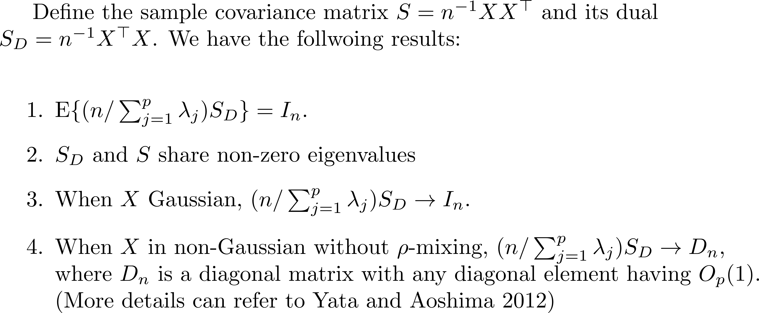
Remark 2:

Slide 23
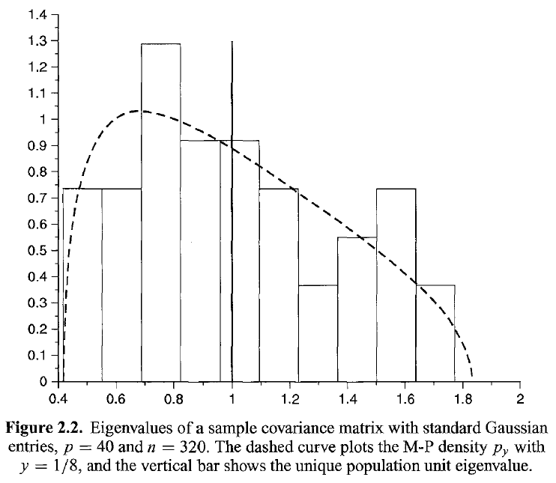
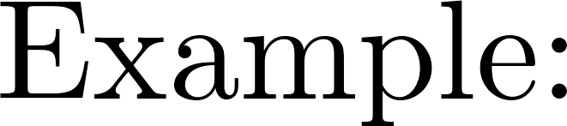

Slide 24
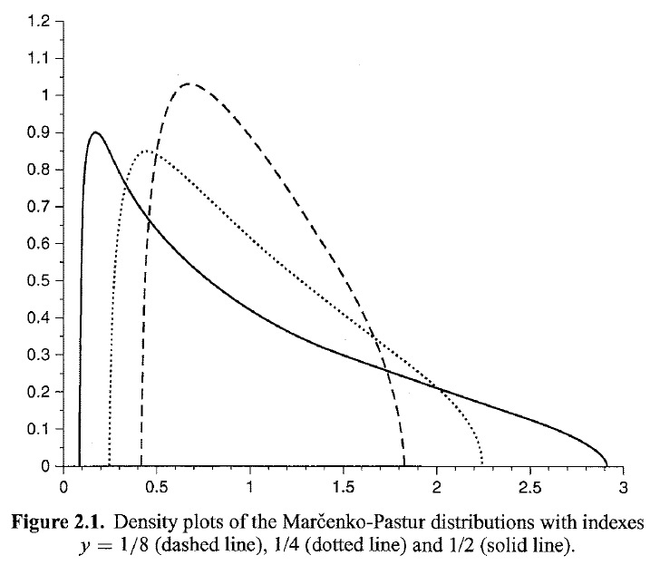

Slide 25
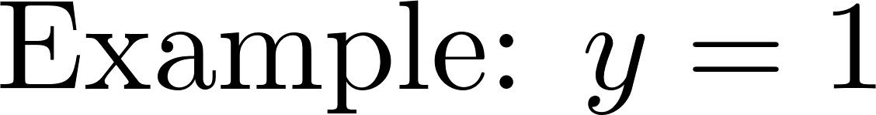
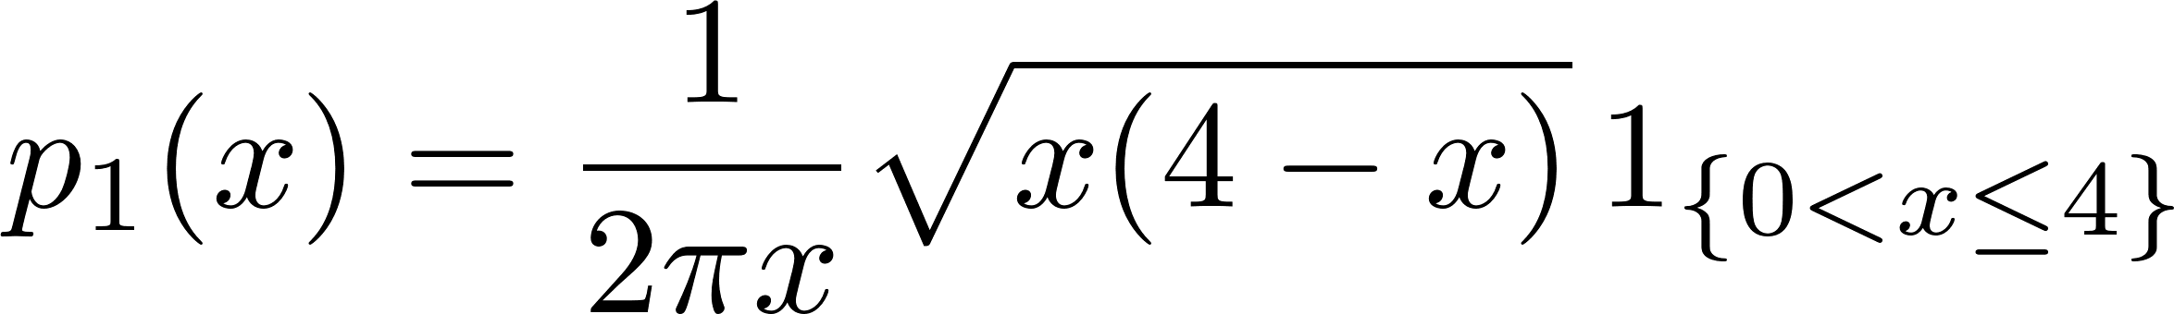
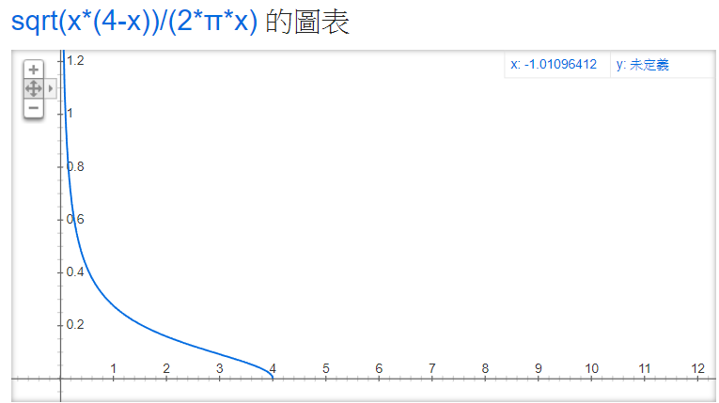


Slide 26
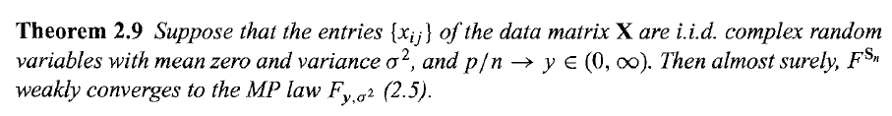
A fundamental theorem

Slide 27
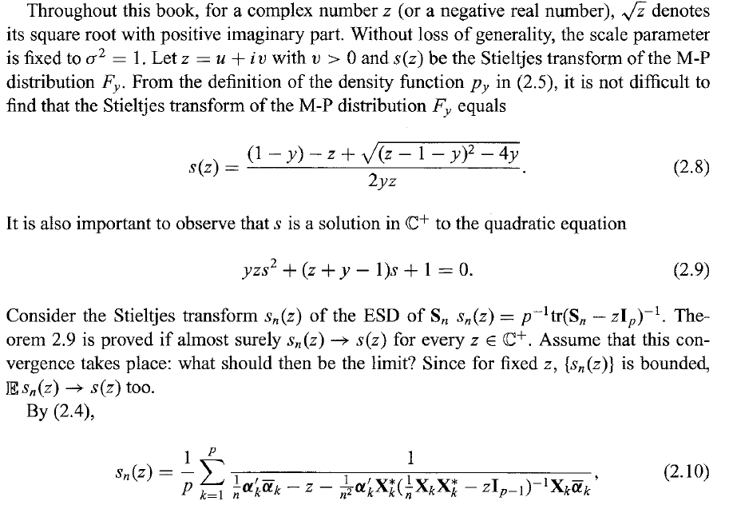
Sketch of the proof.

Slide 28
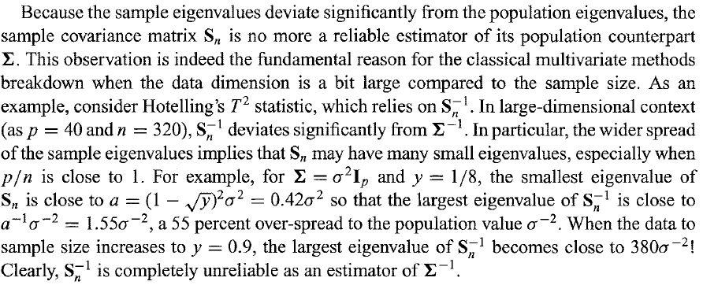
Remark 3:

